Slide 1
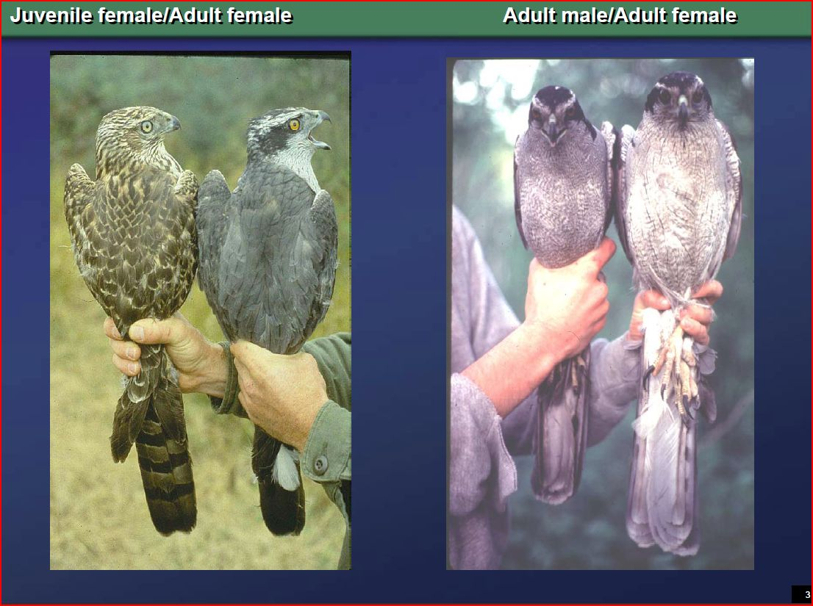
Northern Goshawk Recovery Strategy (laingi subspecies)
April 29, 2014

Slide 2
Overview
History of planning
Schedule for Recovery Strategy
Issues of Concern to Operations

Slide 3
History of Planning
Sept 2012: Licensees and BCTS submitted comments on draft Recovery Strategy for NoGo (laingi subspecies)
October 23/24, 2014: Northern Goshawk Workshop (Nanaimo)
March 17, 2014: Northern Goshawk Structured review of Available Information (Webinar Discussion)
March 28, 2014: Final Deadline for submission of information to be considered in next draft of Northern Goshawk Recovery Strategy

Slide 4
Schedule for Recovery Strategy
(approximately 2 months behind schedule now)
December, 2013 Development of Parks Canada’s Structured Review of Information Sources. The review will include published and unpublished literature as well as all other sources of information that can support Northern Goshawk laingi subspecies recovery planning (see template attached).
Development of the review will include one on one discussions (by phone) with all key knowledge holders, as required.
January, 2014 Completion of draft Structured Review of Information Sources.
The review will be distributed to all participants that attended the October 2013 workshop in Nanaimo as well as other key partners – 30 days will be provided for review.

Slide 5
Schedule of Recovery Plan
(approximately 2 months behind schedule now)
February 2014 Parks Canada will conduct any final follow up discussions (by phone) as required, before finalizing the content of a revised recovery strategy.
April, 2014 Completion of revised draft recovery strategy. Both the revised draft recovery strategy and the completed Structured Review of Information Sources will be sent to BC SARCC agencies (Environment Canada and BC) and all potentially affected and interested parties on the BC coast (all forest license holders, First Nations with traditional territory or other lands implicated, private landowners, industry associations, etc) – 6 weeks will be provided for review.
PCA will make final revisions and initiate internal approvals for posting.
August, 2014 Proposed recovery strategy posted on the SAR Public Registry – 60 day public comment

Slide 6
Issues of Concern to Operations
Primarily around size of forage area and impacts to operating/tenure areas (potentially 1000s of hectares/nest)

